Slide 1
For Live Session
UNIT 3
Carlos Estevez

Slide 2
For Live Session: Unit 3
Part 1: We would like to analyze the Left Midfielders (LM) versus the Left Forwards (LF). (Estimated / expected time: 2 – 4 hours and at least 2+ slides).
1-Using the FIFA player data set, filter the data set to create a dataframe that has just the Left Midfielders (LM) and Left Forwards (LF).
2-Use Ggally and ggpairs() and the dataset you created above above, to plot the categorical variable Position (LM and LF), versus the continuous variables Acceleration and Agility.
3-Given the plot above, what relationships do you see? Comment on these.
4-Your client would like to formally test if the mean agility rating of left midfielders is different than that of the left forwards. Perform a 6 – step t-test to test for the difference in these means. (You may skip step 2 (draw and shade) if you like. If you are unfamiliar with the 6-step hypothesis test, see Stat 1 slides or the Bridge Course to review the 6-step hypothesis test.)
5-Are the assumptions of this test reasonably met? If you have not had Stat 1, simply create a histogram of the agility scores for both groups (LM and LF) and given what you know about the CLT, comment on if you believe the sampling distribution of sample means (of your sample size) will be reasonably normal. In addition, does there look like there is significant visual evidence to suggest the standard deviations are different? ….. If you have had Stat 1, create the plots listed above (and any other plots you might prefer) and be prepared to be a teacher and teach what you know about the assumptions of the t-test and if those are assumption are reasonably met here.

Slide 3
For Live Session: Unit 3
Part 2: (Estimated / expected time 3-5 hours and at least 3+ slides)
Select/create at least 2 categorical variables and select two continuous variables and perform an EDA. Also, at least one of the categorical variables should be created from a continuous variable (using the cut() function).
Use these variables to explore the data and tell a story of what you discovered similar to what was shown in the asynch videos. You do not need to go so far as to use linear regression, but let your curiosity guide you along the way and feel free to use methods you are familiar with that are appropriate to answering those questions. Your evidence could be purely visual or could include additional methods, it is up to you… just do your best and have fun!

Slide 4
For Live Session: Unit 3
Part 2: (Estimated / expected time 3-5 hours and at least 3+ slides)
Select/create at least 2 categorical variables and select two continuous variables and perform an EDA. Also, at least one of the categorical variables should be created from a continuous variable (using the cut() function).
Use these variables to explore the data and tell a story of what you discovered similar to what was shown in the asynch videos. You do not need to go so far as to use linear regression, but let your curiosity guide you along the way and feel free to use methods you are familiar with that are appropriate to answering those questions. Your evidence could be purely visual or could include additional methods, it is up to you… just do your best and have fun!

Slide 5
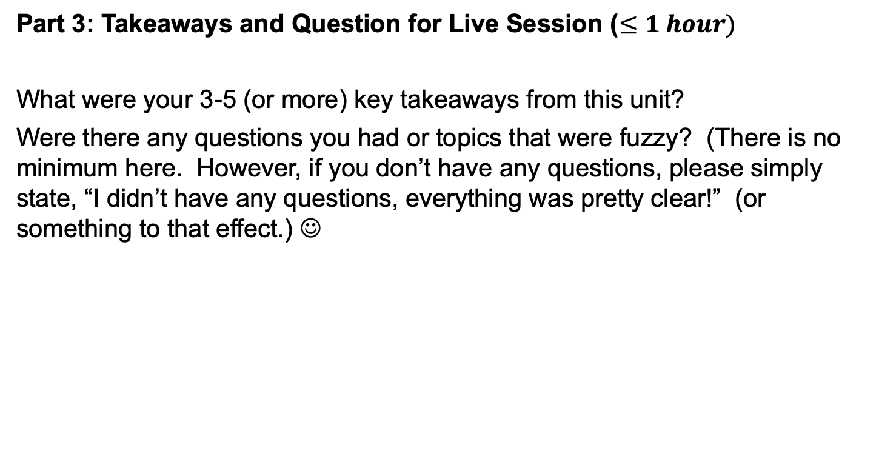
For Live Session: Unit 3
Part 3: Takeaways and Question for Live Session ($≤1 hour)$
What were your 3-5 (or more) key takeaways from this unit?
Were there any questions you had or topics that were fuzzy? (There is no minimum here. However, if you don’t have any questions, please simply state, “I didn’t have any questions, everything was pretty clear!” (or something to that effect.) ☺

Slide 6
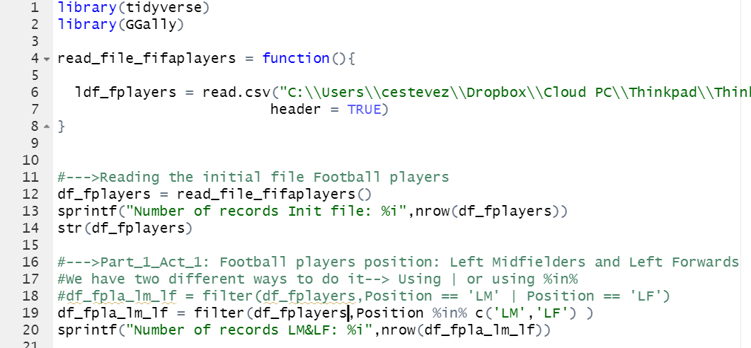
Part 1, Activity 1
Using the FIFA player data set, filter the data set to create a dataframe that has just the Left Midfielders (LM) and Left Forwards (LF).
Comments:
We use the function read_file_fifaplayers to read the CSV file
We use filter to select the players in the positions LF and LM
We can use or(|) or %in% to make this filter

Slide 7
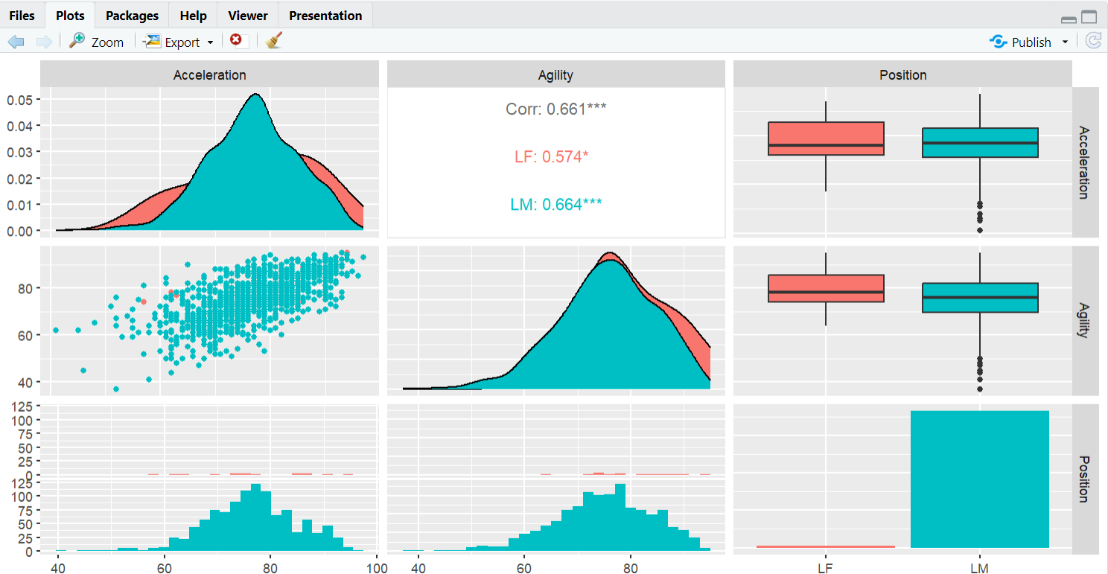
Part 1, Activity 2
Use Ggally and ggpairs() and the dataset you created above above, to plot the categorical variable Position (LM and LF), versus the continuous variables Acceleration and Agility
Image: Plotting Acceleration, Agility and Position using GGPais from GGally

Slide 8
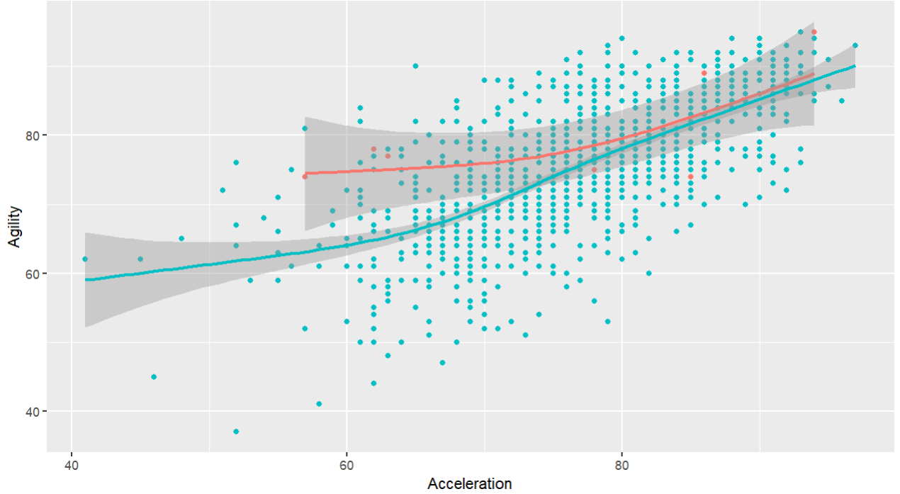
Part 1, Activity 2 and 3
Use Ggally and ggpairs() and the dataset you created above above, to plot the categorical variable Position (LM and LF), versus the continuous variables Acceleration and Agility
Given the plot above, what relationships do you see? Comment on these
Comments:
The evidence suggest that there’s a linear relationship between acceleration and agility, however this relationship is not that strong
One more thing, it seems that the linear relationship is much stronger when it comes to the LM position, on the other hand, for the LF position there’s no enough observations to get to the same conclusion
If you take a look at the correlation coefficient we can validate this assumption. It is much higher for LM position than LF positions
Image: Plotting Acceleration, Agility and Position using GGPais from GGally

Slide 9

Part 1, Activity 4
Your client would like to formally test if the mean agility rating of left midfielders is different than that of the left forwards. Perform a 6 – step t-test to test for the difference in these means. (You may skip step 2 (draw and shade) if you like. If you are unfamiliar with the 6-step hypothesis test, see Stat 1 slides or the Bridge Course to review the 6-step hypothesis test.)
Step 1:
H0: UxLM = UxLF
df = Nm+Nf -2 = 1108
xbarLM = 75.38
xbarLF = 79.73
Sdm = 9.26
Sdf = 8.31
Sp = 9.25
Step 3: Find the T Value
T = -1.8109
Step 4: Find p-value
P = 0.070
Step 5: P>0.01 , so we fail to reject H0
Step 6: There’s no enough evidence to suggest that the mean of the left midfielders is different than the left forwards, So It seems that in terms of agility both players are equally efficient.
Image: Plotting Acceleration, Agility and Position using GGPais from GGally

Slide 10
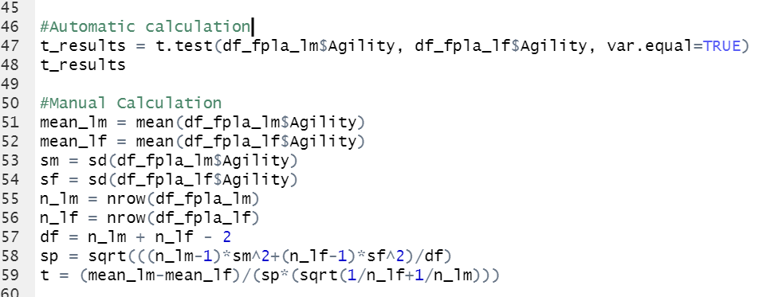
Part 1, Activity 4
Your client would like to formally test if the mean agility rating of left midfielders is different than that of the left forwards. Perform a 6 – step t-test to test for the difference in these means. (You may skip step 2 (draw and shade) if you like. If you are unfamiliar with the 6-step hypothesis test, see Stat 1 slides or the Bridge Course to review the 6-step hypothesis test.)
Comments:
We have two different ways to calculate an Hypothesis test.
1-We can use the function t.test
2-We can use the formulas and make the calculation manually
Image: Plotting Acceleration, Agility and Position using GGPais from GGally

Slide 11
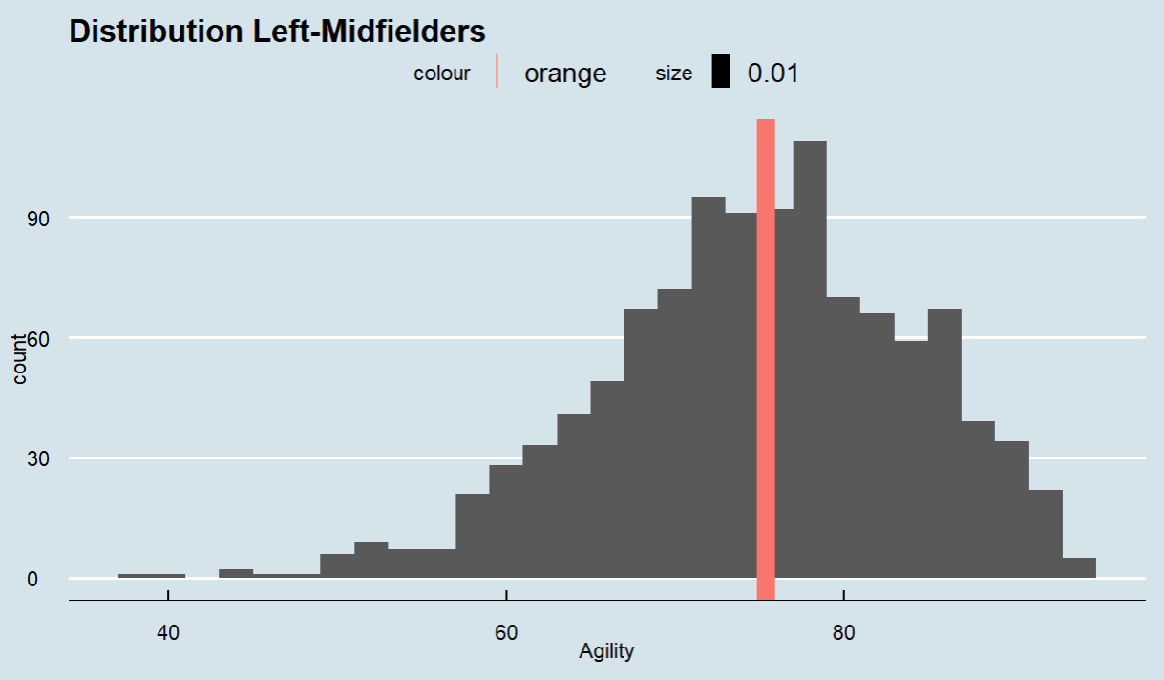
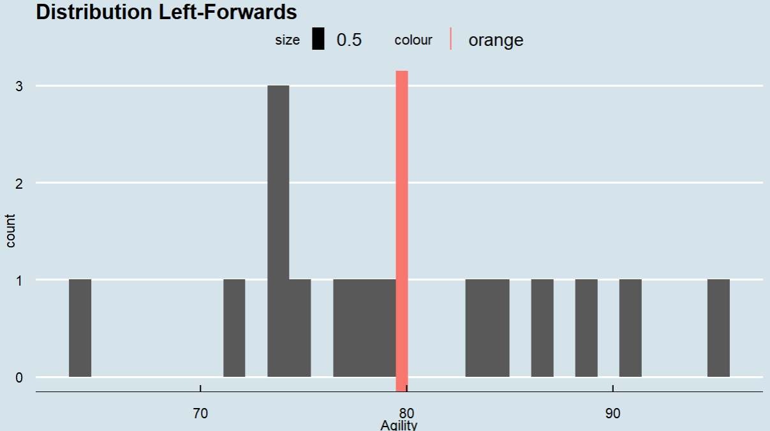
Part 1, Activity 5
Are the assumptions of this test reasonably met? If you have not had Stat 1, simply create a histogram of the agility scores for both groups (LM and LF) and given what you know about the CLT, comment on if you believe the sampling distribution of sample means (of your sample size) will be reasonably normal. In addition, does there look like there is significant visual evidence to suggest the standard deviations are different? ….. If you have had Stat 1, create the plots listed above (and any other plots you might prefer) and be prepared to be a teacher and teach what you know about the assumptions of the t-test and if those are assumption are reasonably met here.
Image 1: Distribution LM
Image 2: Distribution LF
Image: Plotting Acceleration, Agility and Position using GGPais from GGally

Slide 12
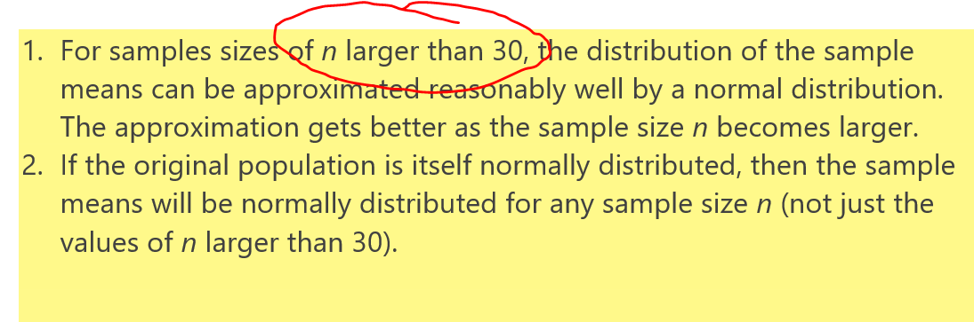
Part 1, Activity 4
Are the assumptions of this test reasonably met? If you have not had Stat 1, simply create a histogram of the agility scores for both groups (LM and LF) and given what you know about the CLT, comment on if you believe the sampling distribution of sample means (of your sample size) will be reasonably normal. In addition, does there look like there is significant visual evidence to suggest the standard deviations are different? ….. If you have had Stat 1, create the plots listed above (and any other plots you might prefer) and be prepared to be a teacher and teach what you know about the assumptions of the t-test and if those are assumption are reasonably met here.
Comments:
I think they are not because we don’t have enough observations for Left-Forward players
We know by the definition of CLT that if the sample size of N is larger than 30 then the sample mean can be approximated reasonably. In addition to that, if you take a look at the plot of LF players we can notice that we don’t have enough observation to simply make a decision about that dataset. The T-Test is useless under these conditions
The sample size of LF is 15 and 1095 for LM. The mean for the agility for LF is ~79 and 75 for LM. So, it means that the LF players are the best in this category, that’s false because let’s suppose that you have taken the sample of the best LF players of the world, it is not accurate to get to that conclusion, because the sample needs to be representative
Image 2: CLT Theory
Image: Plotting Acceleration, Agility and Position using GGPais from GGally

Slide 13
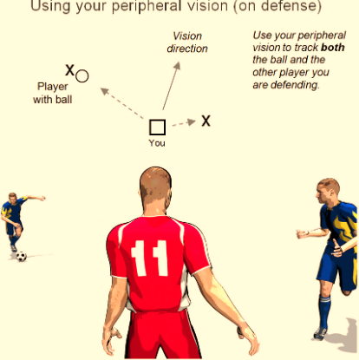
Part 2, Activity 1
Select/create at least 2 categorical variables and select two continuous variables and perform an EDA. Also, at least one of the categorical variables should be created from a continuous variable (using the cut() function).
Introduction
Peripheral vision is one of the most important characteristic of a player. The very good players posses this characteristic
A good peripheral vision is extremely vital in sports like football. Players use their peripheral vision to see and sense movement to either side of them. As a football player drives the ball down the field, he must use peripheral vision to guide his path and avoid tackles
Q1:Using the data of FootballPlayer we want to know if the overall ranking of a player is related with the following characteristics
Vision
Short passing skills
Long passing skills
Skill moves
Image1:Pheripheral vision

Slide 14
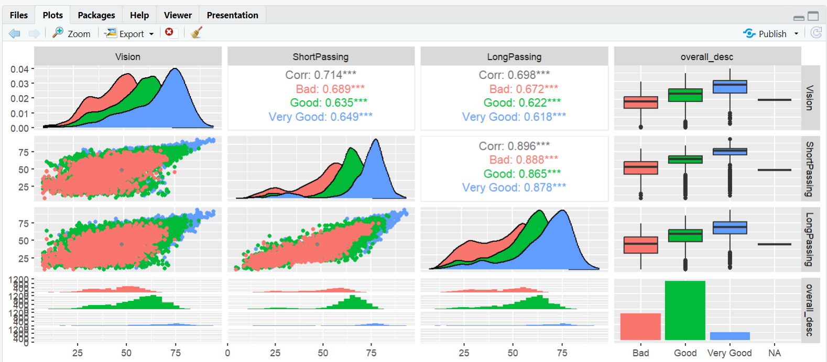
Q1:Step 1: Plotting the data
Image1:Vision/Short Passing/Long Passing

Slide 15
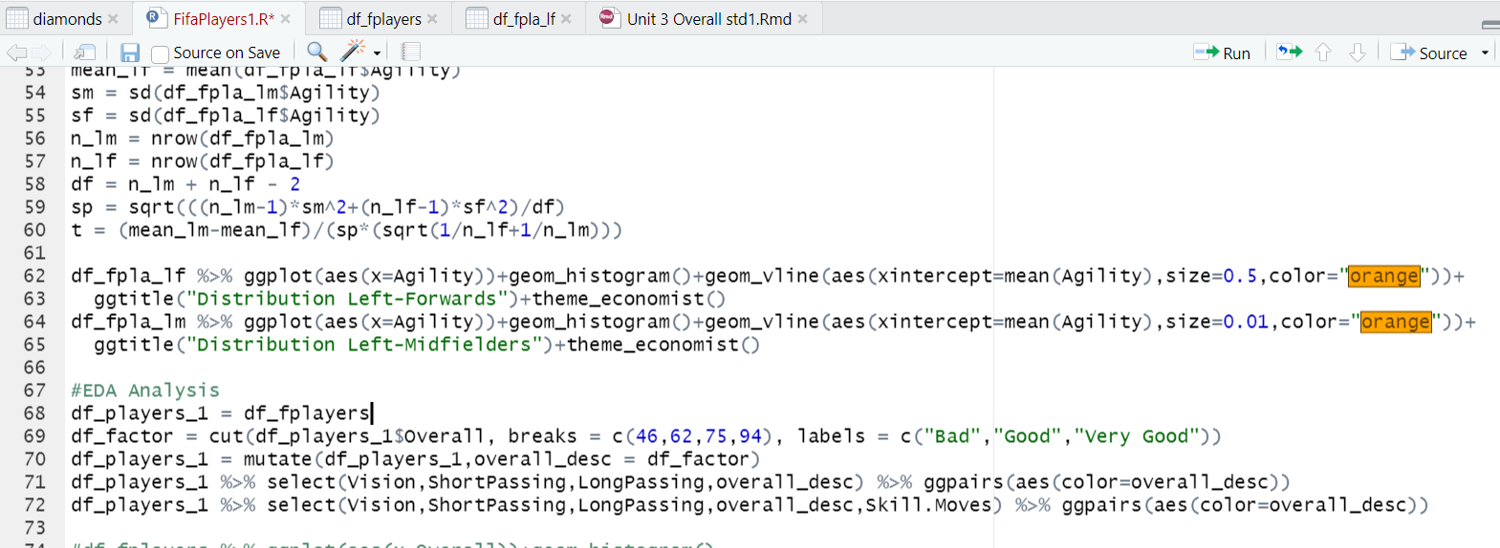
Q1:Step 1: Plotting the data
Code
EDA Analysis
Image1:Vision/Short Passing/Long Passing

Slide 16
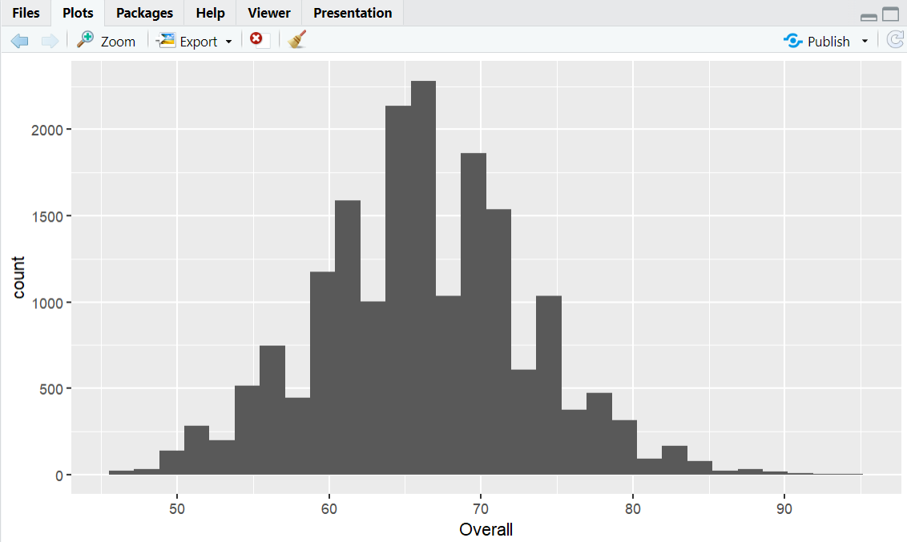
Q1:Step 1: Plotting the data
Continues variable→categorical variable(Overall_Desc)
Bad
Good
Very Good
Image1:Vision/Short Passing/Long Passing

Slide 17
A1:Step 1: Plotting the data
As we can see in the plot there’s a strong positive linear relationship between The vision of a player and the long and short passing skills
Another important fact is what the boxplot indicates. The very good player has a better overall ranking. It means that having a great vision plays an important role in how good a player is
The coefficient correlation also corroborate these facts
The evidence also suggest that in terms of passing skills vision is more relevant when it comes to short passing skills than long passing skills
Image1:Vision/Short Passing/Long Passing

Slide 18
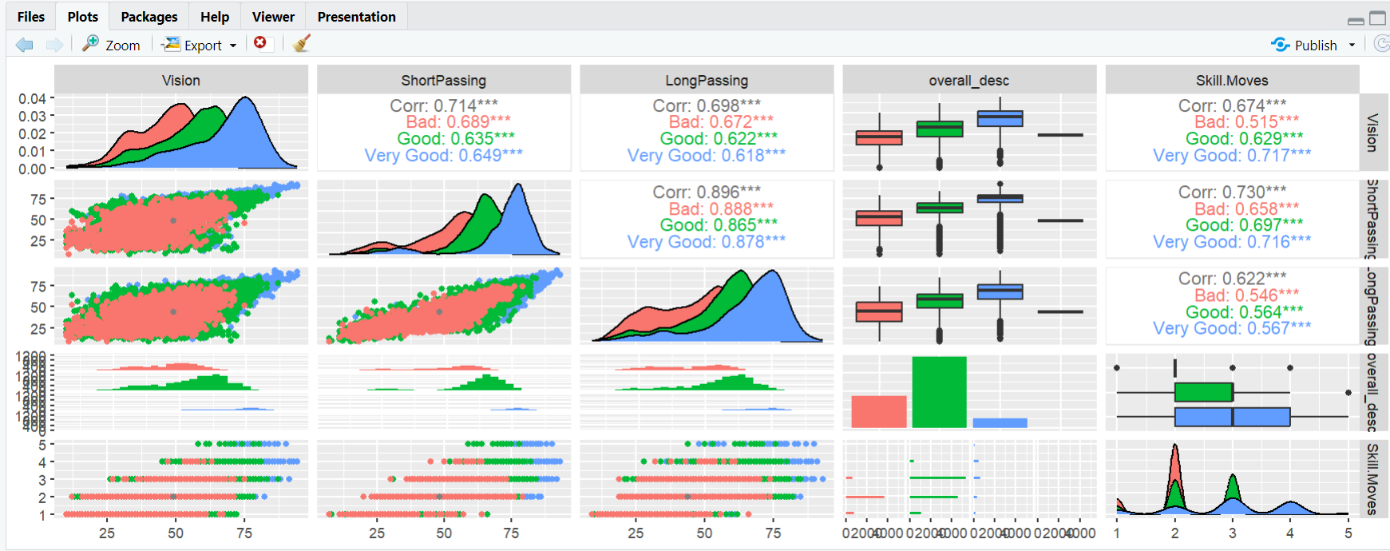
Q1:Step 1: Include a new variable: Skill moves
We want to know if vision and passing skills are related to the overall ranking
Image1:Vision/Short Passing/Long Passing

Slide 19
A2:Step 1: Plotting the data
As we suspected Skill moves is also related to the vision, short passing and long passing skills as we can see from the correlation coefficient
Conclusion
The evidence suggests that Vision is an important part of a player and it is related to many aspects of the player’s game including:
Passing skills
Skills moves
And the overall ranking
Image1:Vision/Short Passing/Long Passing

Slide 20
For Live Session: Unit 3
Part 3: Questions
When it comes to outlier we have seen that the correct approach is to replace them with NA values. Is it better to replace them with a more plausible values, for example the Means?
Do you think is feasible to detect outliers by just looking at the Times Serie?
Over the past several years I have struggled cleaning outliers when I experience intermittent demand(Pharmaceutical retailers). I have used several methods including 1.5IRQ and 3.5 away from the standard deviation, but nothing works. It seems that I am not using the correct approach to tackle outliers when it comes to events with high variability. Do you know a correct approach? What is the correct method to identify outliers?

Slide 21
For Live Session: Unit 3
Part 3: Takeaways
EDA is really useful, because it gives us a structure to explore the information and delve deeper into the data
Ggpairs is really amazing since it gives us an overview right away of the data and the relationship between your variables(Continuous and Categorical)
To me it was very useful to learn how to deal with covariation
We need to have enough information get make final statement about the data. This is something we saw with the t-hyp test of two different group of playes where one group has a small number of observations

